Slide 1
Remote Keyboard
Prepared by
Arjun J. Anghan(16IT002)
Fenil K. Godhani(16IT023)

Slide 2
Content
Problem Statement
Project Overview
Tools and Technologies
Socket Programming
Robot Class
App Screenshot
References

Slide 3
Problem Statement
If you’ve been looking for a new way to control your PC’s keyboard and mouse from Android application. This is way to control your pc using this application without any physical connection.
Suppose you give presentation and you want to control your mouse and keyboard from anywhere in this situation this application will very helpful.

Slide 4
Project Overview
Remote Keyboard allows you to wirelessly control their mouse and keyboard. The application enables you to easily use your smartphone as a keyboard and mouse. Confirm that both the PC and the mobile device are connected to the same wireless network. When your devices are on the same Wi-Fi network, Remote Keyboard will detect by PC IP address and port number.
The application includes an on-screen keyboard. You can type anything in application keyboard and it will type in notepad. You can move your finger along the empty space to control your cursor.

Slide 5
Tools and Technologies
Programming language : JAVA
Android Studio
IDE : NetBeans

Slide 6
Socket Programming
Socket programming is a way of connecting two nodes on a network to communicate with each other. One socket(node) listens on a particular port at an IP
When client wants to connect with server it will send request to the server with two argument
1. IP address
2. Port number.

Slide 7
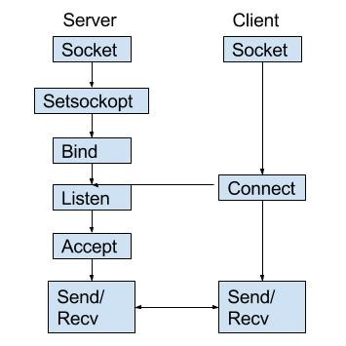
State diagram for server and client model

Slide 8
Robot Class
The Robot class in the Java AWT package is used to generate native system input events for the purposes of test automation, self-running demos, and other applications where control of the mouse and keyboard is needed.
The primary purpose of Robot is to facilitate automated testing of Java platform implementations. In simple terms, the class provides control over the mouse and keyboard devices.

Slide 9
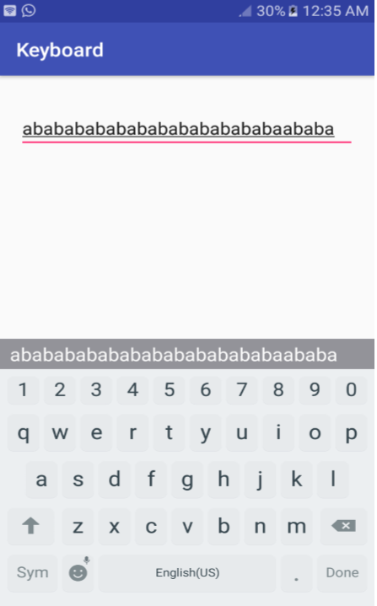
App Screenshot
Massage are typing in to application

Slide 10
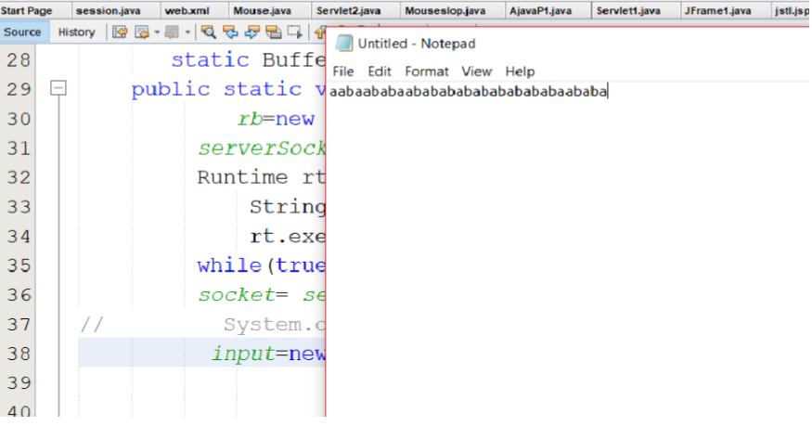
Your massage are type on Notepad

Slide 11
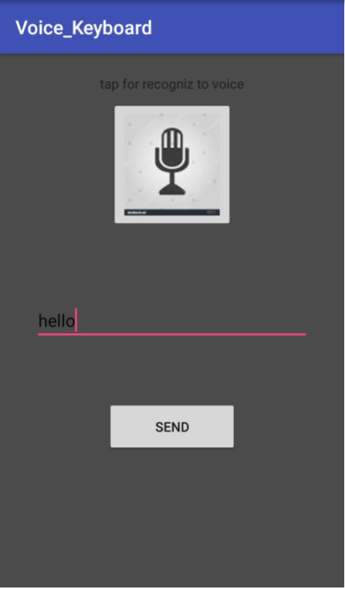
Voice Keyboard Activity

Slide 12
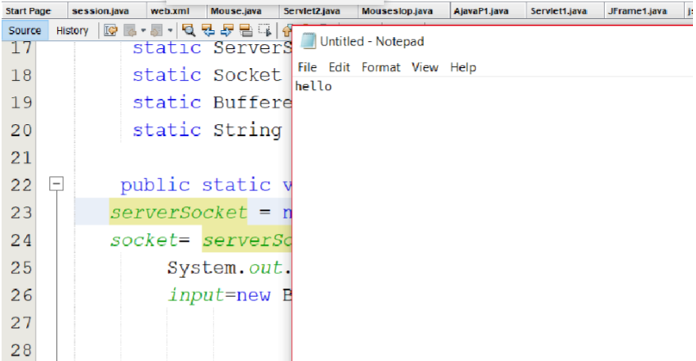
massage is typing in your Notepad

Slide 13
References
https://stackoverflow.com/
https://www.tutorialspoint.com/
https://www.geeksforgeeks.org/

Slide 14
Thank You...

